Slide 1
CNN GENERATED IMAGES ARE SURPRISINGLY EASY TO SPOT
FOR NOW
TEAM - TENSOR
TEAM MEMBERS
Thashmitha BS(11941250) ------Yadava Kishore(11940310)

Slide 2
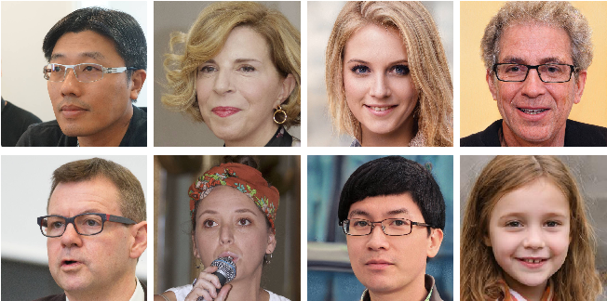

INTRODUCTION
The aim of this research is to develop a "universal detector” for detecting CNN-generated images.
Sheng-Yu-Wang ,trained model on ProGAN images and classified real and fake images with Resnet-50.
We implemented code by training model with StyleGAN images and used Resnet-152 as classifier.

Slide 3
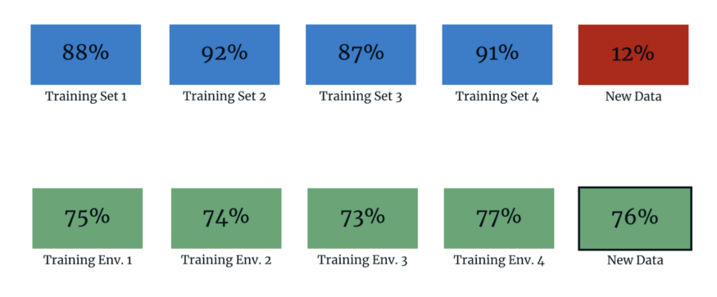
OBJECTIVE
Our goal is to build an “universal detector” for detecting CNN generated images.
Generalization refers to the model ability to adapt to new and previously unseen data.
The main idea of our experiment:
Train the model on a StyleGAN dataset
Evaluate how well the model generalizes to other CNN-synthesized images.
MAIN FOCUS OF MODEL - To increase the generalizability of the model to classify real and fake images

Slide 4

DATASET USED
Training dataset: https://drive.google.com/file/d/132WMLKn65vgYGjUEGOF2x34-Q17dw-Wv/view?usp=sharing
Validation dataset: https://drive.google.com/drive/folders/1FlgtItrY9pbhNRBcPaKZDHf3NNI8_Bth?usp=sharing
Testing Dataset: https://drive.google.com/file/d/1z_fD3UKgWQyOTZIBbYSaQ-hz4AzUrLC1/view

Slide 5
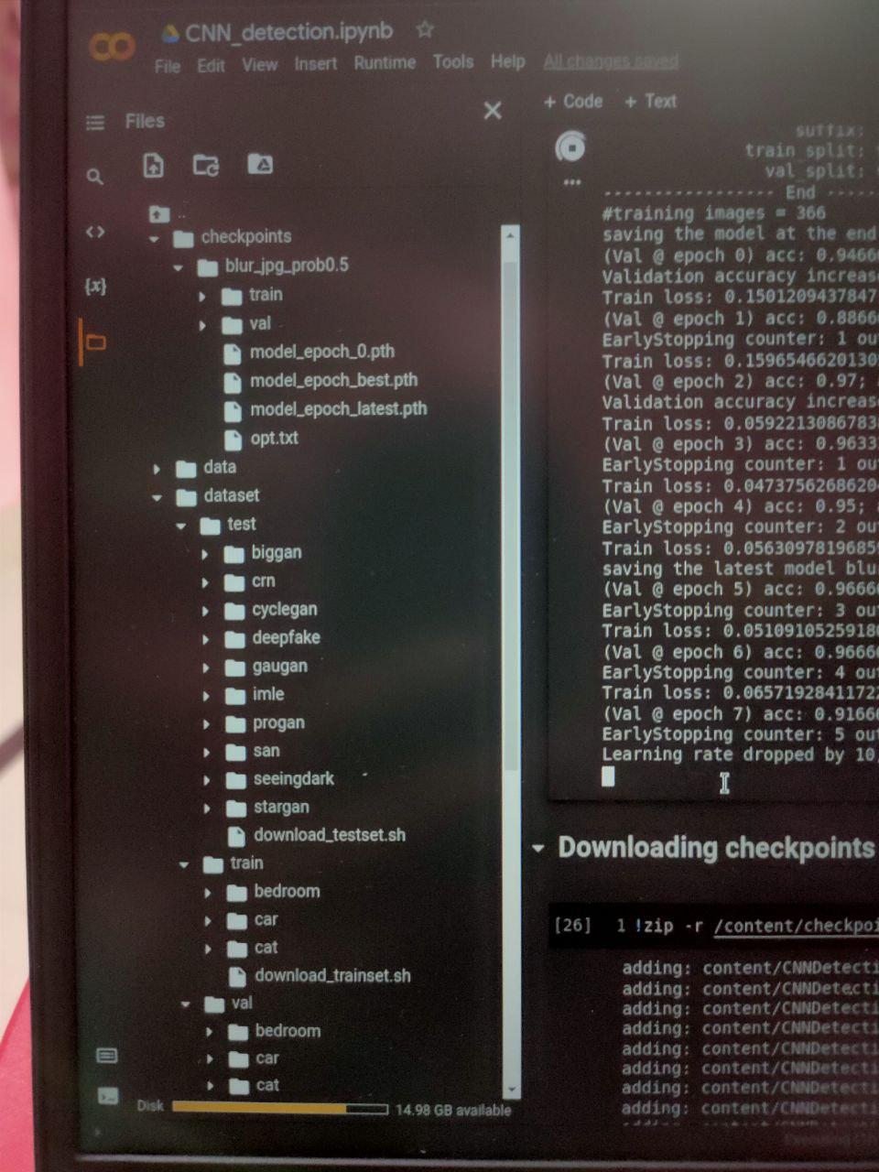
STRUCTURE OF DATASET
Train and validation datasets (Stylegan images):
Both real and fake images
3 classes
Bedroom
Car
Cat
Tested on images generated by 10 different CNN models ProGAN, Big-GAN, CycleGAN, StarGAN, GauGAN, DeepFakes, CRN, IMLE, SITD, SAN.

Slide 6
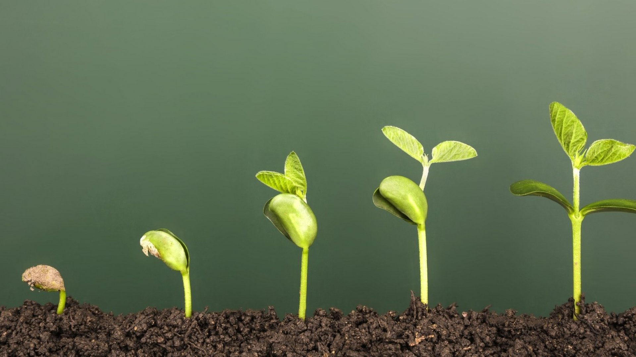
UPGRADATION
Finally we trained our model on Google colab.
We trained it on Stylegan dataset which is of 3 classes and 12k images.
Trained model with binary classifiers based on pre-trained architectures - Resnet101 and Resnet152.

Slide 7
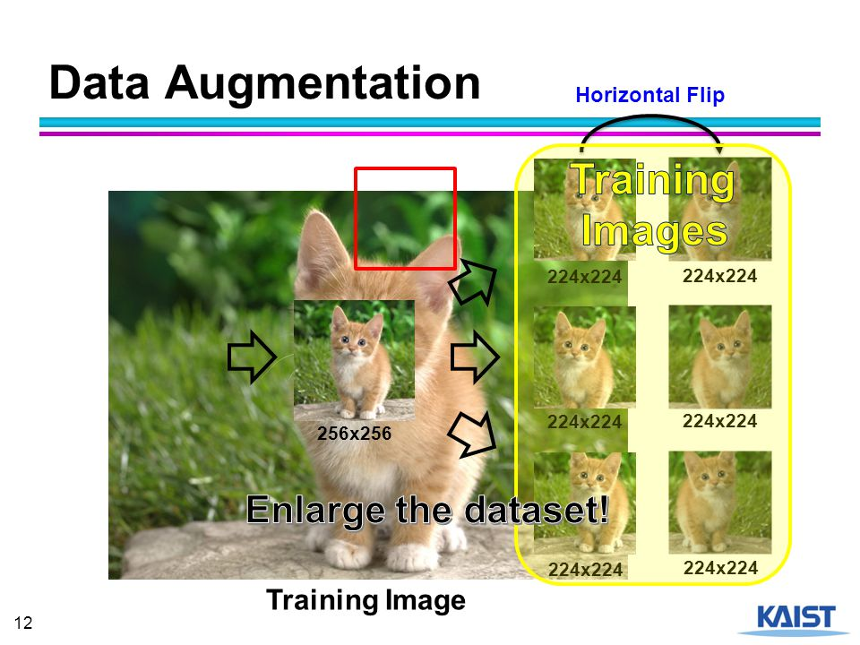
PREPROCESSING STEPS
256×256 resolution is the most commonly shared output size. This is the Image resolution for our dataset.
For models that produce images at lower resolutions(DeepFake): rescale the images using bilinear interpolation to 256 on the shorter side with the same aspect ratio.
For models that produce images at higher resolution (ProGAN, StyleGAN, SAN, SITD)we keep the images at the same resolution.
For all datasets, we make our real/fake prediction from 224 × 224 crops (random-crop at training time and center-crop at testing time)

Slide 8
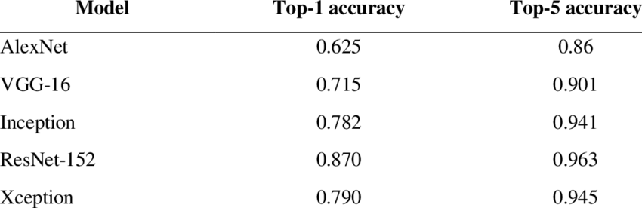
MODELS AVAILABLE
Dataset Generation:
ProGAN
StyleGAN
BigGAN
Any unconditional GAN can be chosen.
Real or Fake Classifier:
ResNet
DenseNet
VGGNet
Inception
Xception

Slide 9

MODEL CHOSEN
Dataset Generation:
StyleGAN
High-performing unconditional GAN model
StyleGAN is an upgraded version of ProGAN.
Model trained on StyleGAN dataset generalizes well to other
CNN generated images.
Real or Fake Classifier:
Used both Resnet101 and Resnet152 - compared their results
Networks with large number of layers can be trained easily without increasing the training error percentage.

Slide 10
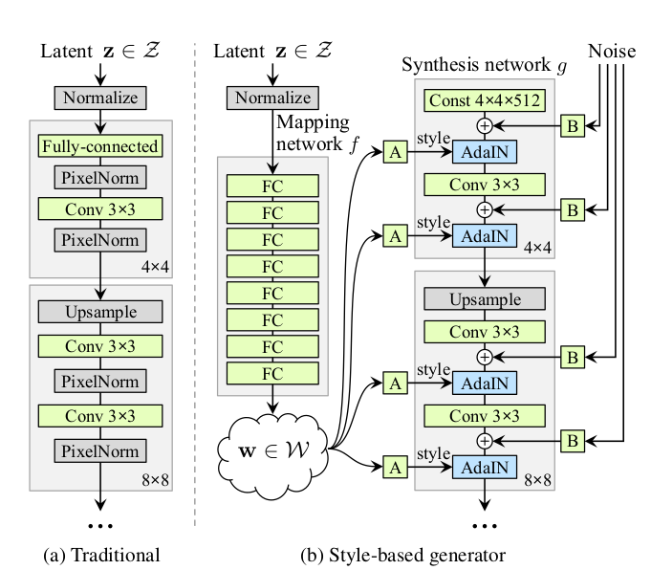
STYLEGAN ARCHITECTURE

Slide 11
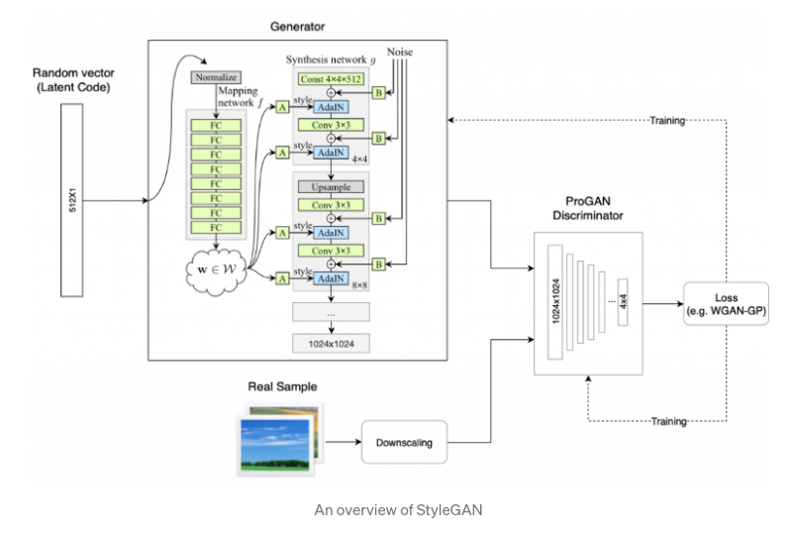
STYLEGAN ARCHITECTURE

Slide 12
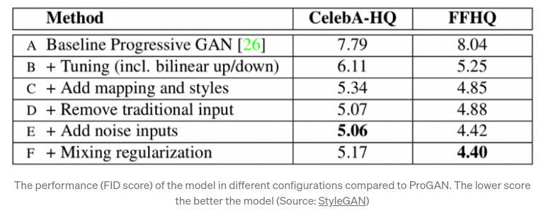
STYLEGAN ARCHITECTURE

Slide 13
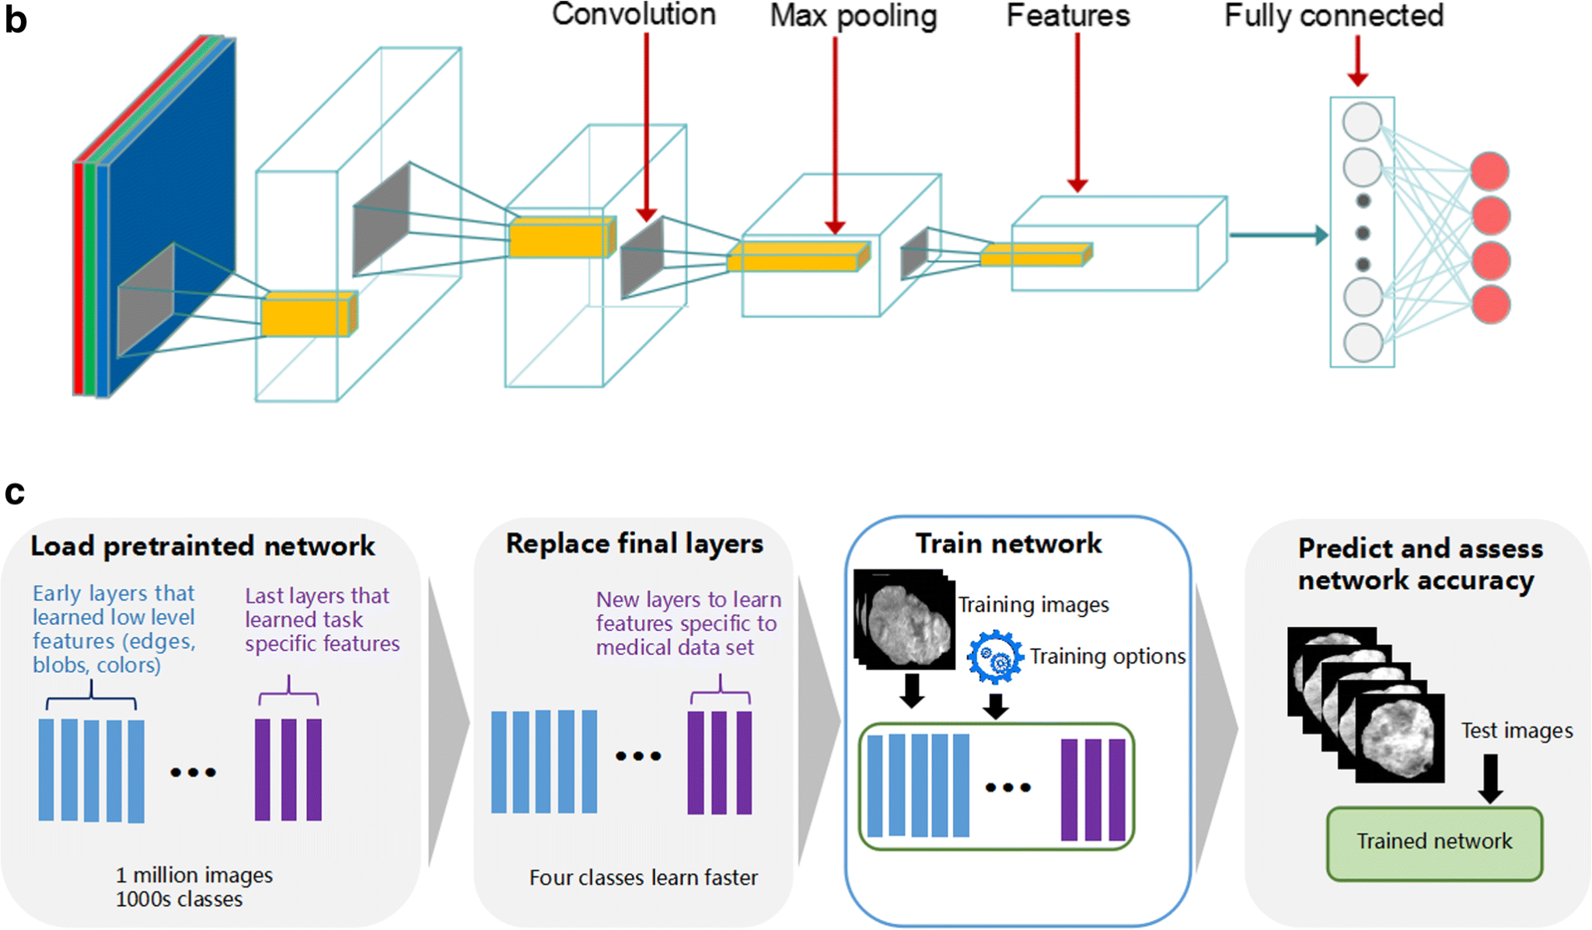
CLASSIFIER ARCHITECTURE

Slide 14
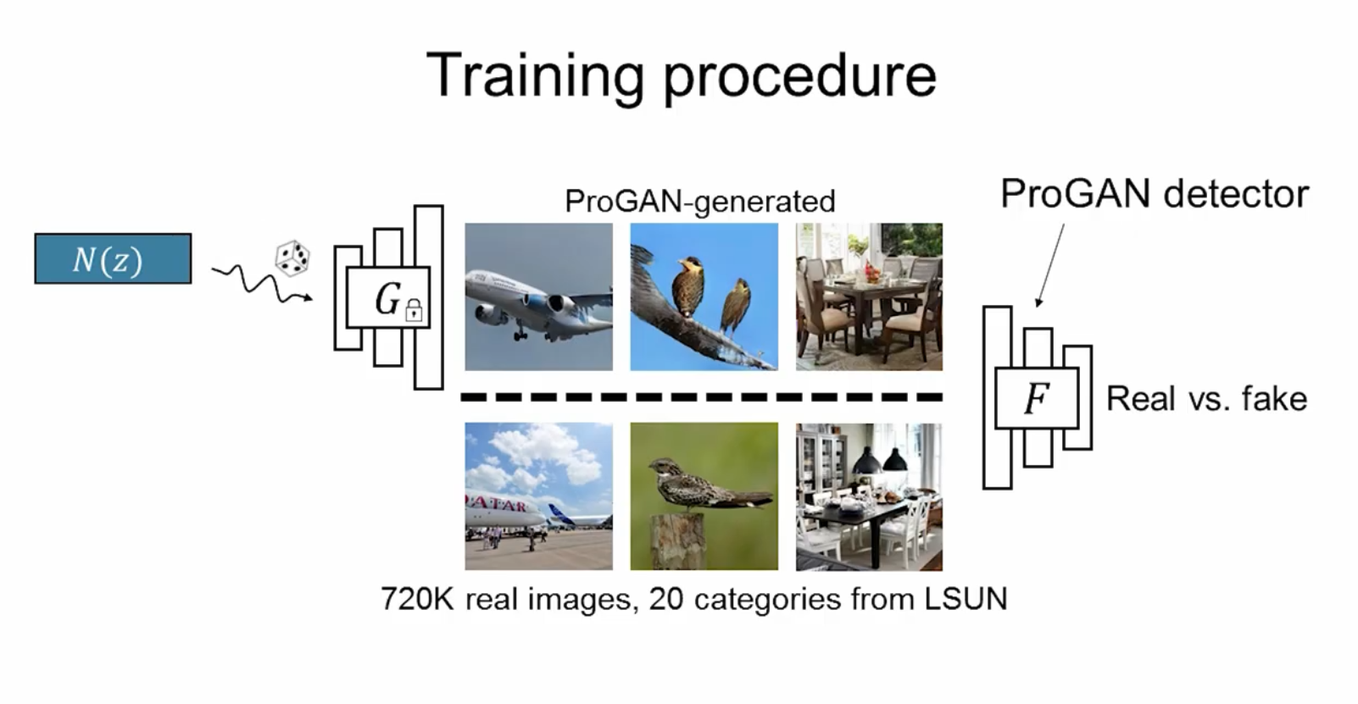
MODEL ARCHITECTURE
STYLEGAN GENERATED IMAGES
BINARY -CLASSIFIER
TRAINING OF MODEL
Trained on generated images by StyleGAN and real images.
The validation dataset was utilised to fine-tune the hyperparameters of model.

Slide 15
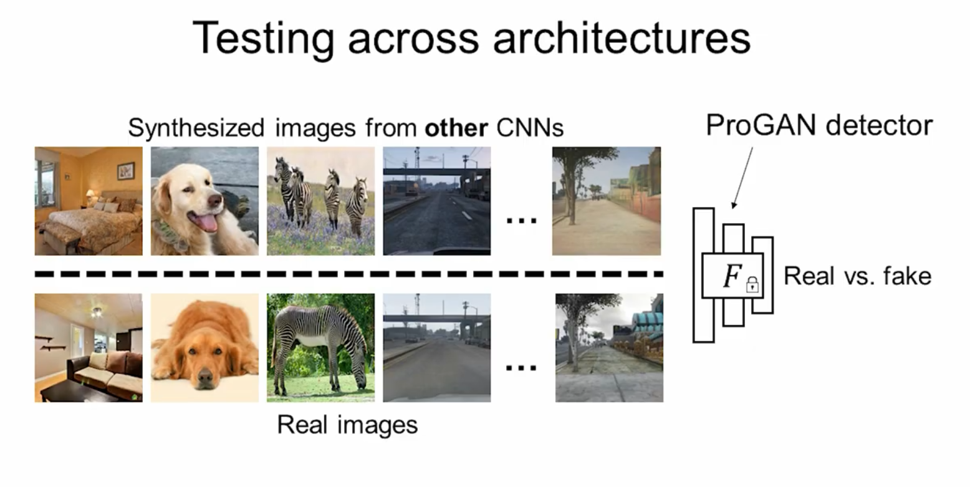
MODEL ARCHITECTURE
BINARY -CLASSIFIER
TESTING THE MODEL
Testing the model on diverse dataset generated by 10 different CNN models
To check generalization of model used ResNET-101 and ResNET-152 as binary classifier to detect real and fake images.
Applied Augmentation Blur+JPEG (0.5) which offers good balance.

Slide 16
IMPLEMENTATION OF CODE

Slide 17
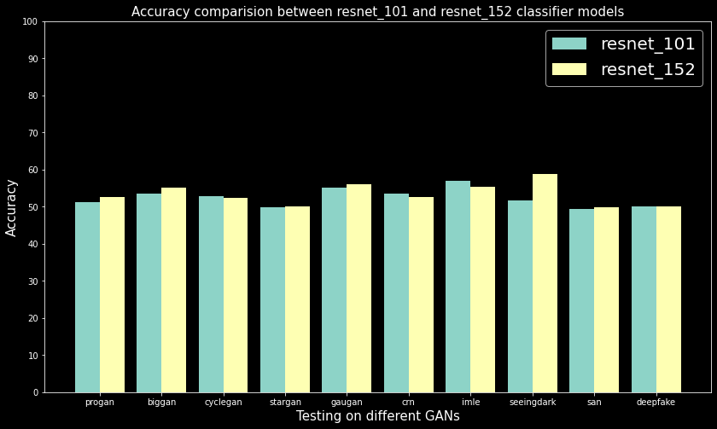
RESULTS

Slide 18

CONCLUSION
We have trained our model on a very small dataset, so didn’t get higher accuracy.
Training on large dataset results in higher accuracy
Also the dataset we have trained consists of only 3 classes.
Increasing the diversity in the dataset also increases the model accuracy.

Slide 19
THANK YOU
THANK YOU

